Slide 1
Leadership Development
Representing multiple orthopaedic subspecialty societies, the following members of the Fellowship Education Coalition authored this lecture:
Ryan C. Goodwin, MD, FAOA
Anthony “AJ” Johnson, MD, FAOA
Jonathan F. Dickens, MD, FAOA
Gabriella E. Ode, MD
Amy L. Ladd, MD, FAOA
Hamid Hassanzadeh, MD

Slide 2
Orthopaedic History
American Orthopaedic Association (AOA) – 1887
1933
1934
American Academy
of
Orthopaedic Surgeons
American Board
of
Orthopaedic Surgery
GME
Orthopaedic Leadership
CME
Advocacy
Certification

Slide 3
Fellowship Year – Transitioning to Independent Practice
ABOS Part I
ABOS Part II
ABOS - Cert/MOC
AAOS – CME
AOA – Leadership, ELP, APEX
Subspecialty Societies
CME/Leadership
ABOS
ACGME/RRC
AOA/CORD
AAOS
9 subspecialties
4yrs
5yrs
1yr
“Life Long Learning”
UGME
Medical School
GME
Residency
6 Core Competencies
Milestones 2.0
Competency based curriculum
Assessment tools
OITE 2.0
GME
CME
Independent Practice
MOC
Fellowship

Slide 4
Transition to Practice Topics
Choosing a practice (SBP)
Contract negotiations (P)
Coding and billing (SBP)
Leadership development (P)
Burnout and physician wellbeing (P)
Personal finance (P)
Healthcare quality: measuring physician performance (PBL, SBP)
Anatomy of the litigation process (P, SBP)
Advocacy (P)
Preparing for ABOS Part II Oral Exam (PBL)

Slide 5
Leadership
Leadership is the ability to influence others to achieve a common goal
Develop a common, adopted vision
Develop strategies to achieve vision
Communicate to those whose cooperation is necessary
Create coalitions/teams that understand & accept vision AND strategies
Motivate to overcome barriers
Provide necessary resources
Fundamentally, every patient encounter and operative case is a leadership opportunity

Slide 6
Levels of Leadership
Leadership can be broadly defined at 3 levels:
Tactical (small group/unit) level dedicated to the immediate actions to achieve the Mission
E.g. Operating room or Clinic
Operational (Division) level dedicated to the integration of other units’ actions into cohesive plan
E.g. Peri-Operative Division (Pre-op, OR, PACU, Discharge units)
Strategic (Department) level dedicated to the long-range planning, resource allocation, and standards & policy towards Mission and Vision
E.g. Department of Orthopaedic Surgery, Hospital C-Suite

Slide 7
Commonly Confused Terms
“We herd sheep, we drive cattle, we lead people” ~ GEN George S. Patton
Management refers to the administration of an organization and stewardship of resources
While good leaders have strong management skills, people generally do not like to be “managed”
Manage resources : Lead people
Command refers to the legal authority to authoritatively direct actions, typically by position/title
While all Commanders are in leadership positions, not all Commanders have strong leadership skills
Command organizations : Lead people
Director refers to a person who oversees an activity or organization
Direct activities : Lead People

Slide 8
Types of Leadership
Transactional
Achieves mission by changing the actions of people
“Carrots vs. Sticks” style of leadership
Change happens quickly but does not persist
Transformational
Achieves mission by changing the beliefs of people
“Charismatic” style of leadership
Change happens slowly over time but persistent

Slide 9
Common Leadership Missteps
Communication
Bias
Poor Feedback
Poor Conflict Resolution

Slide 10
Orthopaedic Organizations
Societies – AOA, AAOS, subspecialty, ABOS, many opportunities
Group Practice – business, c-suite
Hospitals – committees, boards
Department – committees, vice-chairs
Community – church, clubs
Other

Slide 11
Orthopaedic Educational Pathway
ABOS Part I
ABOS Part II
ABOS - Cert/MOC
AAOS – CME
AOA – Leadership
Subspecialty Societies
CME/Leadership
ABOS
ACGME/RRC
AOA/CORD
AAOS
4yrs
5yrs
1yr
“Life Long Learning”
UGME
Medical School
GME
Residency
6 Core Competencies
OITE
Milestones
GME
CME
Independent Practice
MOC
Fellowship (9)

Slide 12
Orthopaedic Educational Pathway – Medical School
ABOS Part I
ABOS Part II
ABOS - Cert/MOC
AAOS – CME
AOA – Leadership
Subspecialty Societies
CME/Leadership
ABOS
ACGME/RRC
AOA/CORD
AAOS
4yrs
5yrs
1yr
“Life Long Learning”
UGME
Medical School
GME
Residency
6 Core Competencies
OITE
Milestones
GME
CME
Independent Practice
MOC
Fellowship (9)

Slide 13
Orthopaedic Educational Pathway – Residency
ABOS Part I
ABOS Part II
ABOS - Cert/MOC
AAOS – CME
AOA – Leadership
Subspecialty Societies
CME/Leadership
ABOS
ACGME/RRC
AOA/CORD
AAOS
4yrs
5yrs
1yr
“Life Long Learning”
UGME
Medical School
GME
Residency
6 Core Competencies
OITE
Milestones
GME
CME
Independent Practice
MOC
Fellowship (9)

Slide 14
Orthopaedic Educational Pathway – Fellowship
ABOS Part I
ABOS Part II
ABOS - Cert/MOC
AAOS – CME
AOA – Leadership
Subspecialty Societies
CME/Leadership
ABOS
ACGME/RRC
AOA/CORD
AAOS
4yrs
5yrs
1yr
“Life Long Learning”
UGME
Medical School
GME
Residency
6 Core Competencies
OITE
Milestones
GME
CME
Independent Practice
MOC
Fellowship (9)

Slide 15
Fellowship Year – Transitioning to Independent Practice
ABOS Part I
ABOS Part II
ABOS - Cert/MOC
AAOS – CME
AOA – Leadership, ELP, APEX
Subspecialty Societies
CME/Leadership
ABOS
ACGME/RRC
AOA/CORD
AAOS
9 subspecialties
4yrs
5yrs
1yr
“Life Long Learning”
UGME
Medical School
GME
Residency
6 Core Competencies
Milestones 2.0
Competency based curriculum
Assessment tools
OITE 2.0
GME
CME
Independent Practice
MOC
Fellowship

Slide 16
Orthopaedic Educational Pathway Independent Practice
ABOS Part I
ABOS Part II
ABOS - Cert/MOC
AAOS – CME
AOA – Leadership, ELP, APEX, Travelling Fellowships
Subspecialty Societies
CME/Leadership
ABOS
ACGME/RRC
AOA/CORD
AAOS
4yrs
5yrs
1yr
“Life Long Learning”
UGME
Medical School
GME
Residency
6 Core Competencies
OITE
Milestones
GME
CME
Independent Practice
MOC
Fellowship (9)

Slide 17
Orthopaedic Educational Pathway Residency
ABOS Part I
ABOS Part II
ABOS - Cert/MOC
AAOS – CME
AOA – Leadership
Subspecialty Societies
CME/Leadership
ABOS
ACGME/RRC
AOA/CORD
AAOS
4yrs
5yrs
1yr
“Life Long Learning”
UGME
Medical School
GME
Residency
6 Core Competencies
Milestones 2.0
Competency based curriculum
Assessment tools
OITE 2.0
RLF
GME
CME
Independent Practice
MOC
Fellowship (9)

Slide 18
Involvement in Orthopaedic Societies
What are your interests?
Clinical development
Networking
Leadership development
Advocacy/policy development
Research and/or innovation
Mentorship/trainee development
Education
GME
CME

Slide 19
Involvement in Orthopaedic Societies
How can I be involved?
Become a member – subspecialty society, AOA, AAOS, other
Apply for a committee, ex., education, advocacy, research, technology
Volunteer as a course instructor
Volunteer as a journal reviewer – subspecialty, JBJS, JAAOS, JOR
Contribute funds for grants/fellowships/resources
Become a mentor to new and emerging leaders

Slide 20
Benefits of Society Memberships
Broadens your professional network
Helps stay up to date on treatment trends & controversies
Increases level of expertise/credentialing
Strengthens practice management
Provides access to research studies/resources
Provides access to traveling fellowships/international opportunities
Increases leadership and professional development opportunities
Offers collaboration with colleagues on advocacy issues
Volunteer opportunities

Slide 21
Orthopaedic Societies
Geographic focus
State
Regional
National
Subspecialty focus
Advocacy/business focus
Clinical practice focus
Specific interest focus

Slide 22
National Surgical Societies
Society | Focus | Membership Details
AAOS N~35,000 | Orthopaedic Surgery – Advocacy, CME, Career and Patient Resources | Resident and Candidate (Board eligible) Membership available
AOA N~ 1800 | Orthopaedic Surgery – Leadership and Academic development | Peer Reviewed Process - nomination by 2 AOA members
SOMOS | Military Orthopaedic Surgeons | Active duty, reserve, retired, and honorably discharged Orthopaedic surgeons and/or active fellows in a fellowship training program. Also includes non-military
RJOS | Women in Orthopaedics | Open to all genders Student, Resident and Candidate (Board eligible) membership available
JRGOS | Underrepresented Minorities in Orthopaedics | Open to all ethnicities; Student, Resident and Active membership available
AALOS | Orthopaedic Surgeons of Latino Descent | Open to all ethnicities; Student, Resident and Active membership available
AWS | Women in Surgery | Open to all genders and surgical specialties

Slide 23
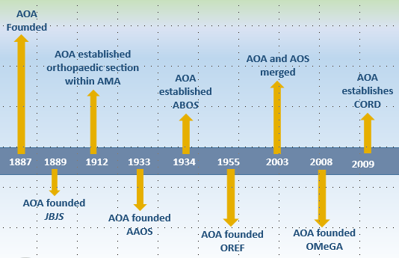
AOA Timeline

Slide 24
AOA’s Mission
Engaging the orthopaedic community to develop leaders, strategies, and resources to guide the future of musculoskeletal care.

Slide 25
AOA’s Vision
AOA will inspire the orthopaedic community to excellence through leadership.

Slide 26
Goals & Objectives
Identify Leaders (at all levels!)
Develop and enhance competency of orthopaedic leadership
Confront the most relevant issues facing orthopaedics
Collaborate with other orthopaedic organizations to achieve excellence through leadership
AAOS
ABOS
Subspecialty Societies
Residents/Fellows

Slide 27
AOA Programs
C. McCollister Evarts Resident Leadership Forum (RLF) - R4
Emerging Leaders Program (ELP)—32-45
Emerging Leaders Forum (ELF)
Other leadership and career development opportunities
Traveling Fellowships – Age 35-45
North American Traveling Fellowship (NATF)
American British Canadian (ABC)
Japanese Orthopedic Association (JOA)
Austrian Swiss German (ASG)
AOA USC APEX Leadership Program – Age 35-60
Partnered with USC
Business/Leadership Development Program
AOA Membership
Committees (Multiple Opportunities)
Council of Orthopaedic Residency Directors (CORD)
Residency education leadership

Slide 28
Regional Societies
Regional Societies
Eastern Orthopaedic Association
Mid-America Orthopaedic Association
Mid-Central States Orthopaedic Society
New England Orthopaedic Society
North Pacific Orthopaedic Society
Southern Orthopaedic Association
Western Orthopaedic Association
Canadian Orthopaedic Association
State Level Orthopaedic Societies

Slide 29
Subspecialty Societies
Society | Subspecialty | Position Categories | Minimum Criteria
AAHKS | Total Joint/Adult Recon | Arthroplasty Surgeon in Training Candidate Member | Resident Board Eligible; AAOS Member
AANA | Arthroscopy | Resident/Fellow Member Associate Member Active Member | Resident or Fellow Board Eligible Board Certified
AOFAS | Foot and Ankle | Surgeon in Training Candidate Member | Resident/Fellow only Board Eligible; AAOS Member
AOSSM | Sports Medicine | Resident Member Candidate Member | Resident; must attend AOSSM meeting within 4 years Sports fellow or <1 year out of fellowship’ must attend AOSSM meeting within 4 years

Slide 30
Subspecialty Societies (cont’d)
Society | Subspecialty | Position Categories | Minimum Criteria
ASES | Shoulder and Elbow | Fellow Member Candidate Member | Fellow in ASES fellowship or fellowship with 1+ ASES members Completed ASES fellowship or fellowship with 1+ ASES members
ASSH | Hand/Wrist | Candidate Member | Within 3 years of orthopaedic residency
MSTS | Oncology | Candidate Member | Enrolled or completed MSTS fellowship
NASS | Spine | Associate Member Active Member | Board Eligible Board Certified; >50% spine practice
OTA | Trauma | Candidate Member | Trauma fellowship or equivalent training
POSNA | Pediatric Ortho | Candidate Member | Resident accepted in peds fellowship; >50% pediatric practice

Slide 31
Specific Leadership Development Programs
Society | Program
AOA | RLF, Emerging Leaders Program, AOA Traveling Fellowships
ORS | Women Leadership Forum
ASSH | Young Leaders Program
AOFAS | Women’s Leadership Initiative

Slide 32
Typical Requirements for Subspecialty Society Membership (after fellowship)
Application Form
Board Certification (ABOS), some have SSC requirements.
Curriculum Vitae
Sponsor form(s) – from program director, fellowship director, society member or peers
Professional Photo
Application Fee

Slide 33
Am I overextending myself?
Remember to prioritize your patients and clinical practice
Start by focusing involvement in a couple areas of interest
Expand involvement as time dictates
Don’t overpromise/underdeliver
Learn how and when to say “no” or “I cannot right now”
On joining committees: “Join to make a difference…in a positive way!”

Slide 34
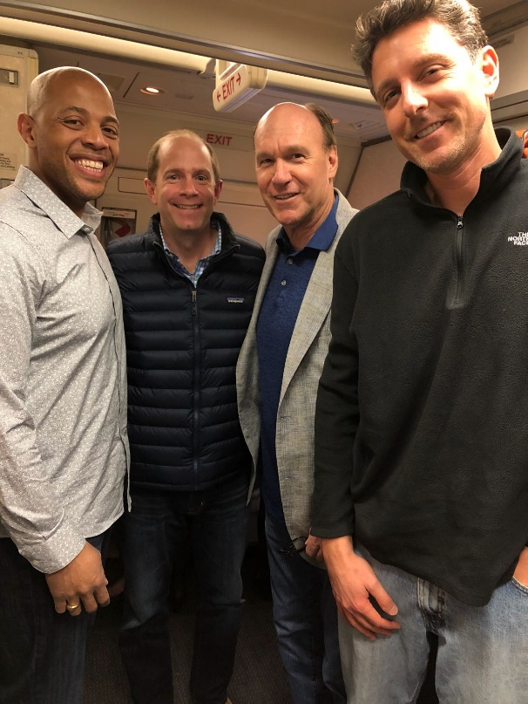
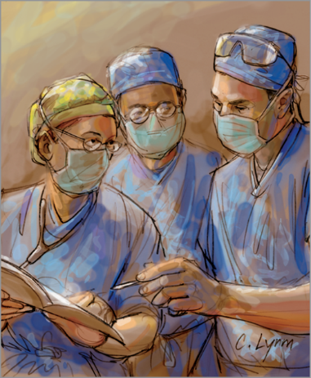
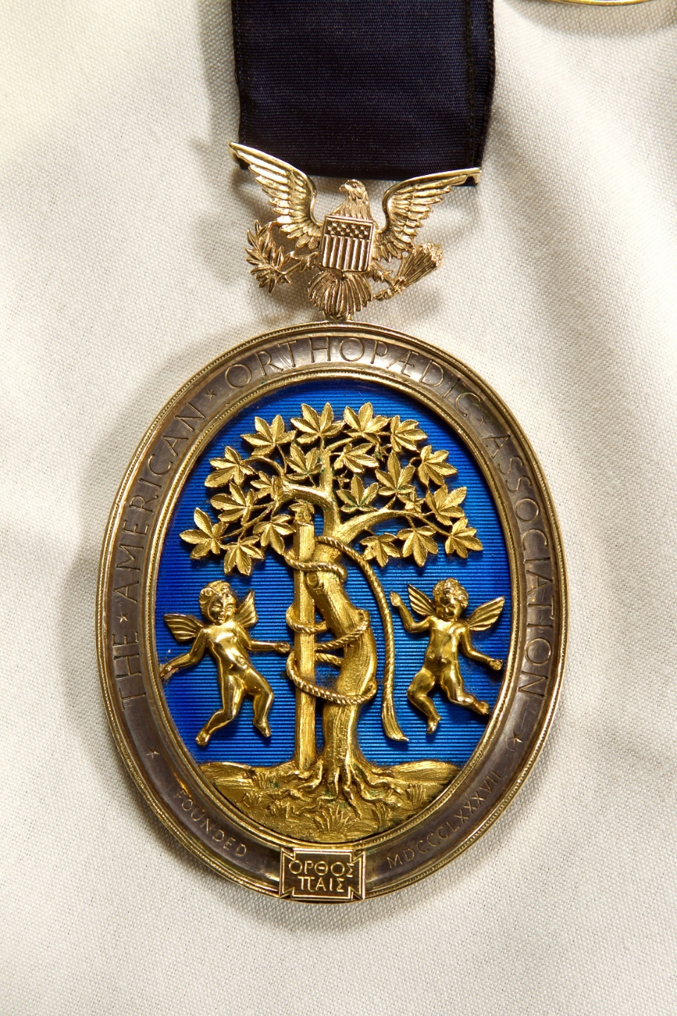
“Be a Leader, Make a Difference, Enjoy!” - Dick Burton, MD
Notes:
Engaging the orthopaedic community to develop leaders, strategies and resources to guide the future of musculoskeletal care.

Slide 35
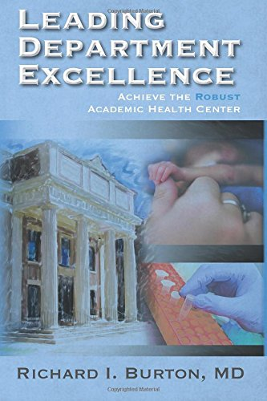
“Always do the right thing. This will satisfy some people and astonish others.”
- Benjamin Franklin
Thank You!

Slide 36
Please help us improve our support of best practices in education: Use this survey to provide your feedback about this module.
Submit questions or comments about the
Transition to Practice Lecture Series to cord@aoassn.org

