Slide 1
Contract Negotiations
Representing multiple orthopaedic subspecialty societies, the following members of the Fellowship Education Coalition authored this lecture:
James Holmes, MD, FAOA
Anthony Bratton, MD
Antonia F. Chen, MD, MBA
Drew A. Lansdown, MD
Brian R. Waterman, MD, FAOA
Special Thanks to Michael J. McCaslin, CPA of Somerset Advisors of Indianapolis for his thoughtful review and suggestions on this topic.

Slide 2
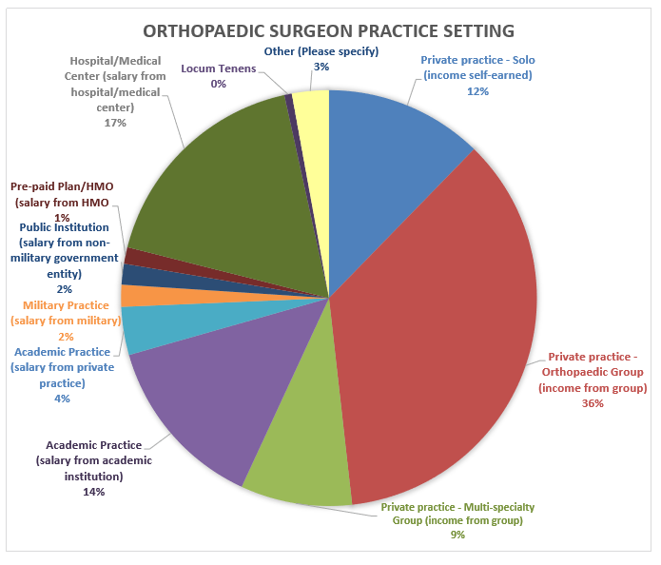
Transition to What Environment?
2018 Orthopaedic Census Report – AAOS

Slide 3
Overview
WHO are you negotiating with?
WHAT items are you negotiating?
HOW does one go about this process?
WHERE can I turn for help?
Fellow/Faculty Evaluation
Use this survey to provide your feedback about this module.

Slide 4
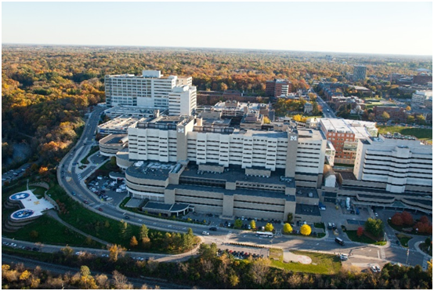
Who
…are you negotiating with?
Contracts vary with practice environments:
Private practice
Multispecialty group
Hospital/health system
Academic appointment

Slide 5
What
…items are you negotiating?
In the contract….
On-Call obligations
Call stipend
Teaching stipend
Clear path to partnership
Research support
Academic productivity metric
Consulting/ Royalties
Compensation formula
Terms of employment
Benefits
Ancillary income opportunity
Bonus (signing, initiation, moving, etc)
Malpractice coverage
Separation/ Termination

Slide 6
What
…items are you negotiating?
Compensation formula
Yours vs Partners
Additional $ with goals achieved?
Penalty for shortfall?
When did it last change and why?
Ancillary income calculation?
Overhead
How is it calculated?
Fixed vs Variable
Accounting
Charges vs Collections vs RVUs vs wRVU with multiplier vs blended
Ancillary income
How and when is it allocated? Obligations? Buy in? Buy out?

Slide 7
Benefits
Specific options
Health, dental insurance
Disability insurance
Life insurance
Retirement package
CME account
License and professional dues
Loan repayment
Vacation
Eligibility – who and when
Administered by the practice or 3rd party

Slide 8
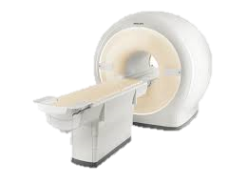
Ancillary Income Opportunities
What are they at this job?
There may be restrictions from state to state
“CON” states (certificate of need restrictions)
Real estate, Imaging, Therapy, Surgery Centers
What is the buy-in?
What is the buy-out?
Are the terms the same for all physicians or are there special deals?

Slide 9
“Bonus”
Sign on bonus
Payable when you sign or when you start?
What happens if either party terminates early?
Educational loan payment
Same termination restrictions as above
Moving expenses
Capped or Uncapped?
Same termination restrictions as above

Slide 10
Malpractice Insurance
Amount
Reported as numbers, the first is the amount per claim per year and the second is the total amount per provider per year. (e.g. “1M/3M”)
Structure
“Tail” coverage if termination
While not spelled out in the contract it is important to understand how malpractice coverage works, who the insurer is and what their track record has been, any restriction in legal counsel, and the structure of the policy. Ultimately, this is very important to protect your personal financial assets.

Slide 11
Separation/Termination
Rights and responsibilities
Obligations
“Notice”, communication, patient notification, etc.
Restrictive covenants
Financial liability
Malpractice tail
Payback of “bonuses” etc.
Payback of any short fall (collections vs salary)

Slide 12
On-Call Obligations / Opportunities
Hospital requirements – typically in bylaws
# of Hospitals?
“Group call” frequency – not ED, but for practice pts
Frequency
Stipend? Amount?
Independent or included in your salary?
Expectations
Hand?, Spine?, Trauma orthopod trained support? That night or next day?

Slide 13
Miscellaneous
Teaching stipend
Royalties
Consulting
Legal work
Expert
IMEs

Slide 14
more… What
…items are you negotiating?
Not in contract
…but need transparency and clarity
Ongoing negotiations?
Strategic plan
QA/QI program
Governance structure
Understand your environment
What do they need from me?
Patient access
Patient distribution
Work environment
Marketing/ promotional plan
OR block time/implant limits
On call expectations

Slide 15
Professional Path
Is Your Path Forward Outlined?
Terms of Employment Agreement
Pathway to Partnership
Clear criteria including timing
How is the decision made
Other promotional opportunities (hospital or group)
Pathway to Promotion
Academic centers
Clinical vs tenure track

Slide 16
How
…does one go about this process?
Initiation
Starting the process
Doing your homework/information sources
Communication
Responsible, punctual
Expectations on both sides
What are your expectations, timeframes, etc., and do they mesh with this employer?
Understanding needs/leverage/expectations
Obligations

Slide 17
Where
…can I turn for help?
MGMA
Mentors
Accountants
Attorneys
Consultants
Proprietary websites
Written resources
Getting to Yes by Roger Fisher and William Ury .… and many others

Slide 18
Additional Educational Resources
AMA GME Competency Education Program. American Medical Association; https://edhub.ama-assn.org/gcep
Babitsky S, Mangraviti JJ. The 10 biggest legal mistakes physicians make in negotiating contracts with their employers. Seak.com; 2005. https://seak.com/blog/uncategorized/10-biggest-legal-mistakes-physicians-make-negotiating-contracts-employers/
Fisher R, Ury W, Patton B. Getting to Yes: Negotiating Agreement Without Giving In. New York: Penguin Books; 2011.
Hofheinz E. Contract negotiation: do thine homework. Orthopedics This Week; Aug 14, 2009. https://ryortho.com/2009/08/contract-negotiation-do-thine-homework/
The Employment Contract Checklist. American Academy of Orthopaedic Surgeons. https://www.aaos.org/uploadedFiles/PreProduction/Membership/Member_Resources/prac_manag/The%20employment%20contract%20checklist.pdf
Williams AC, Althausen PL, Bray T, Walker J. The Orthopaedic Success Manual; 2018. https://coa.org/2018/presentations/84The-Orthopaedic-Success-Manual.pdf

Slide 19
(Optional slide for use in this lecture.) Orthopaedics Add Value to Hospital Systems
Available at https://www.merritthawkins.com/news-and-insights/thought-leadership/survey/2019-physician-inpatient-outpatient-revenue-survey/
Additional resource: https://www.merritthawkins.com/trends-and-insights/article/white-papers/Orthopedic-Surgery-Supply-Demand-and-Recruiting-Trends/

Slide 20
Please help us improve our support of best practices in education: Use this survey to provide your feedback about this module.
Submit questions or comments about the
Transition to Practice Lecture Series to cord@aoassn.org

