Slide 1
Coding and Billing
Representing multiple orthopaedic subspecialty societies, the following members of the Fellowship Education Coalition authored this lecture:
A. Lee Osterman, MD, FAOA
Lutul D. Farrow, MD, FAOA Laurence B. Kempton, MD Albert Lin, MD Praveen G. Murthy, MD E. Peter Sabonghy, MD, FAOA Jacob R. Worsham, MD

Slide 2
Overview
Background
Coding in the Office
Coding in the Operating Room
Additional Resources
Fellow/Faculty Evaluation
Use this survey to provide your feedback about this module.

Slide 3
Goals
Understand the basic terminology and concepts involved in coding for evaluation/management (E/M) and surgery
Understand the application to orthopaedic surgery
Review general guidelines, pearls and pitfalls for code assignments

Slide 4
Language of Coding
CPT: Current Procedural Terminology
Alphanumeric system that represents “all” physician services
RVU: Relative Value Unit
Unit used as the basis for measuring the relative economic value of medical procedures. The units are applied across all of medicine.
ICD-10: International Statistical Classification of Diseases
Medical diagnosis classification list developed by the World Health Organization

Slide 5
Language of Coding
CPT: Current Procedural Terminology
First developed and published by the AMA in 1966
Meant to standardize physician services
No initial connection to reimbursement
In 1983, Centers for Medicare & Medicaid Services (CMS) mandated use of CPT for billing
AMA is responsible for maintenance of and changes to CPT codes

Slide 6
Language of Coding
CPT: Five-digit system
10000 – 19999 Anesthesia
20000 – 69999 Surgery
70000 – 79999 Radiology
80000 – 89999 Pathology
90000 – 99999 Medicine
99201 – 99499 Evaluation/Management

Slide 7
E/M: Evaluation and Management
Key Components
History
Physical Examination
Medical Decision-Making (MDM)
Contributory Factors
Nature of the presenting problem
Extent of counseling
Coordination of care
Time

Slide 8
E/M: Evaluation and Management
New vs. Established
Three-year rule: New patients have not been seen by the treating orthopaedist or another provider in the same practice within the past 3 years
Consultation
Must document request from another physician to either recommend care for a specific problem or determine whether transfer of care will be accepted
Medicare no longer accepts consultation codes as of 2010

Slide 9
E/M: New Patients (99201— 99205)
Reimbursed based on the lowest level among all three key components
History
Physical Exam
Medical Decision-Making (MDM)
Goal for new patient visits: at least level 3
History: always level 4
Physical Exam: at least level 3 (this is the rate-limiting key component)
MDM: at least level 3

Slide 10
E/M: History
Goal: level 4 history (equivalent to level 5)
Not difficult to achieve
Use patient intake forms!

Slide 11
E/M: History
Chief Complaint
History of Present Illness
Location, quality, severity, timing, duration, context, modifying factors, associated conditions
Include 4 of the above
Past (illness, injury, surgery), Family, Social History (PFSH)
Include all 3 for new patients
Do not necessarily need to include medications or allergies
Review of Systems (ROS)
Include at least 10 systems for new patients

Slide 12
E/M: History of Present Illness
History with 4 bullets is easily achieved in a standard orthopaedic evaluation
Simple examples:
“The patient reports [symptom] in [location] for [duration]. The [symptom] is intermittent / constant [timing] and has been worsening / improving [context] since onset.” – 4 bullets
“The patient reports pain in [location] for [duration]. The pain is severe [severity] and does not radiate [quality]. The pain is worse with movement [modifying factors]. There is no associated numbness or tingling [associated conditions].” – 6 bullets

Slide 13
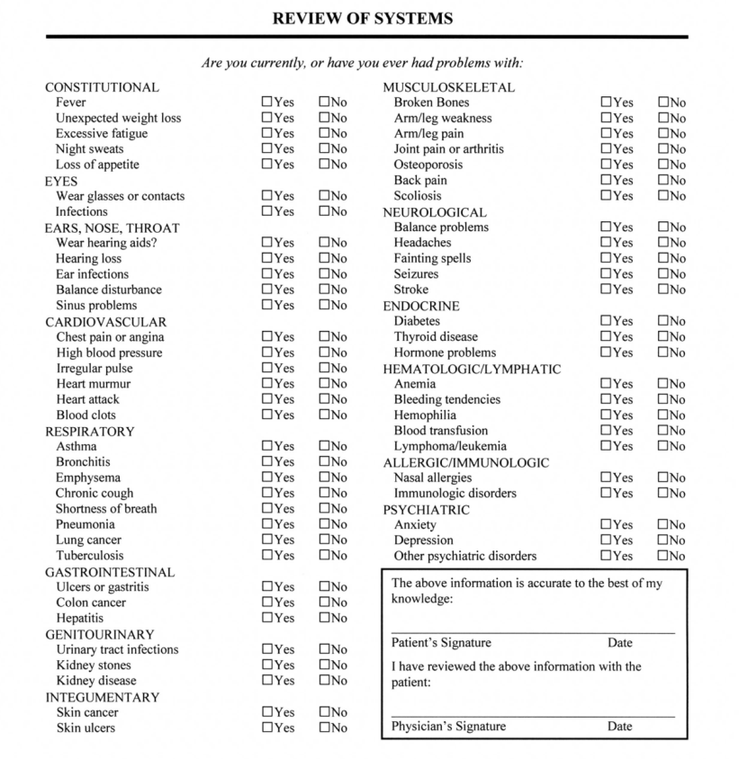
E/M: PFSH + ROS
Use patient intake forms for PFSH, ROS
Past Medical History “was reviewed with the patient and is documented on the patient intake form. Pertinent history includes…”
Family / Social History: “Non-contributory” not allowed. Include pertinent positives.
Review of Systems: similar statement
For these statements to count, you must sign and date the intake form and it has to be scanned into the chart.

Slide 14
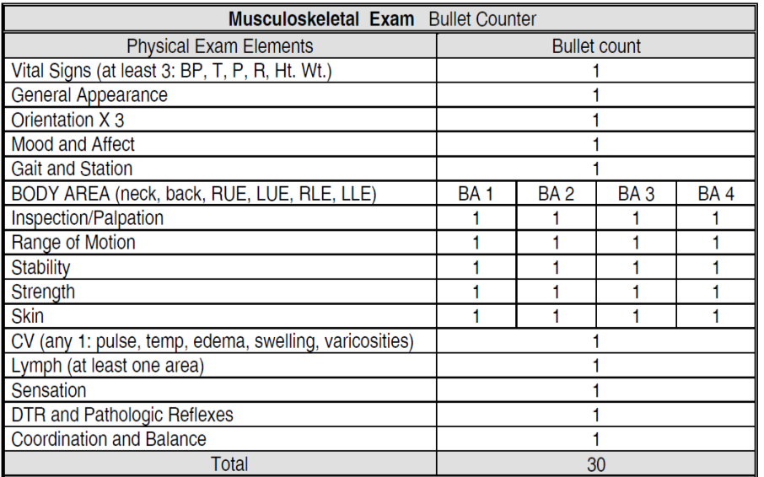
E/M: Physical Exam
For level 3:
General: Well-appearing = 1
Mood: Normal mood and affect = 1
Gait: Ambulates [with normal gait / with assistive device] = 1
Body Areas: “TRIM + skin” x 2 body areas (neck, back, RUE, LUE, RLE, LLE) = 12
TRIM: tenderness, range of motion, instability, muscle strength
Sensation = 1
Pulses = 1
Total = 15 bullets (only need 12)

Slide 15
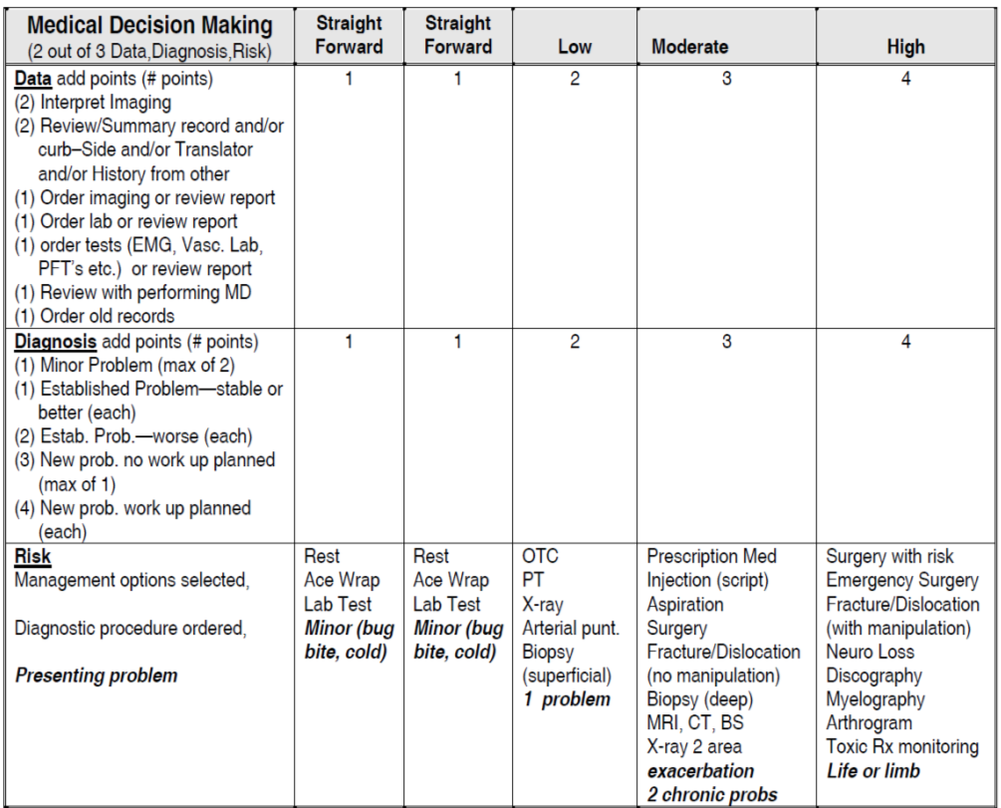
E/M: Medical Decision-Making
For level 3: 2 points in 2 areas
For level 4: 3 points in 2 areas
Data
Order (1) + interpret (2) imaging = 3
Diagnosis
New problem, no work up = 3
New problem + work up = 4
Plan/Risk
OTC meds, PT, XR = 2
Order CT/MRI, aspirate/inject, treat fracture, discuss surgery (any one) = 3

Slide 16
E/M: Time

Slide 17
E/M: Established Visits (99212 – 99215)
Goal for established visits: level 4 where appropriate
For established visits, lower component of top 2 determines code
History: level 4
CC (1), HPI (4), ROS (2), PFSH (1 of 3)
Physical Exam: pass
Medical Decision-Making: level 4
Work backwards
If you write a prescription/inject/schedule surgery, make sure to document history and MDM appropriately and charge for established level 4.

Slide 18
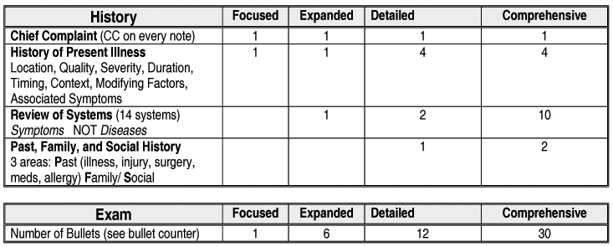
E/M: Established Visits

Slide 19
E/M: Established Visits
Medical Decision-Making uses an identical chart as for new patients
For level 4 visit, must obtain 3 bullets in 2 of 3 areas
Data
Order (1) + interpret (2) imaging = 3
Diagnosis (pass)
Established problem, stable or better (each) = 1
Established problem, worse (each) = 2
Plan/Risk
OTC meds, PT, XR = 2
CT/MRI, aspiration/injection, fracture, discussion of surgery (any one) = 3

Slide 20
E/M: Why is this relevant?
Consult New Estab
Level 1 $50 $44 $21
Level 2 $94 $76 $45
Level 3 $129 $111 $74
Level 4 $188 $170 $109
Level 5 $231 $211 $147
250 patients/month x 12 months/year x $74/patient = $222,000
250 patients/month x 12 months/year x $109/patient = $327,000
Annual net increase for Level 4 established patients = $105,000
Based on 2014 CPT codes and Medicare payment information

Slide 21
E/M: Post-operative Visits
Global Period
Starts with an index surgical procedure and ends at some defined interval thereafter
For major surgery, global period is 90 days
Payment for index procedure covers all additional costs of management during this period
E/M code is 99024

Slide 22
E/M: Modifiers
-24: Unrelated problem treated within surgery global period
-25: Unplanned injection on initial or follow-up evaluation
Cannot bill for E/M visit for planned injections
-57: Decision for surgery

Slide 23
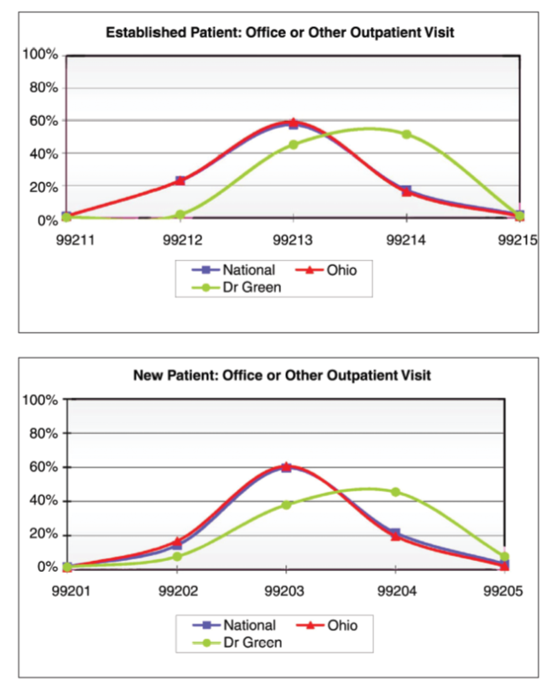
E/M: Pitfalls
Medicare audits occur with:
Overbilling
Underbilling!
Audit red flags:
New level 4 and 5 visits
Established level 5 visits
Do not be an outlier!

Slide 24
E/M: Take Home Points
Document and bill for new patient visits at level 3 (at least) and established visits at level 4 (as often as appropriate)
Billing for level 4 is appropriate for:
Prescription, aspiration/injection, CT/MRI order, fracture/dislocation, surgery discussion
Bill for consultations (when appropriate)
Develop a new patient questionnaire to include PFSH and ROS
Work backwards from MDM to determine level of service

Slide 25
E/M: Future Directions
CMS to institute significant changes to E/M billing requirements in 2021
History and physical exam no longer factors in determining level of service!
CPT code will be determined solely based on Medical Decision-Making (MDM) or Time
MDM calculation will be similar to the current MDM calculation
Time will be defined as total time spent, including non-face-to-face work done on that day, and will no longer require time to be dominated by counseling
New system will be beneficial for orthopaedic surgeons
Majority of our time and effort is spent in Medical Decision-Making
30-bullet physical exam no longer necessary to justify Level 4 new patient visit

Slide 26
Surgical Coding
Surgical coding is generally more straightforward
Each procedure is associated with a single CPT code
The CPT code(s) that are billed should reflect the procedure(s) performed as documented in the operative report
AAOS Musculoskeletal Coding Guide and Web-Based Code-X
Definitive resources for orthopaedic surgical billing
AAOS Complete Global Service Data
Bundling package lists every surgical procedure/CPT code and which codes can and cannot be listed for reimbursement in conjunction with that code

Slide 27
Surgical Coding: Bundling
A bundling package defines which surgical CPT codes can be reimbursed either separately or in combination.
For example, 29880 is the CPT code medial AND lateral meniscectomy. The following procedures are bundled with this code and cannot be billed separately:
29881 – medial OR lateral meniscectomy: is obviously included with medial AND lateral.
28982 – medial OR lateral meniscal repair: cannot be reimbursed when you have performed a meniscectomy
28983 – medial AND lateral meniscal repair: cannot be reimbursed when you have performed a meniscectomy

Slide 28
Surgical Coding: Multiple Procedures
General rules:
List the procedure with the highest number of RVUs in the first position
If secondary procedures are listed, a modifier may be indicated
Be cautious of bundling conflicts as discussed above
Check the AAOS Code-X!

Slide 29
Surgical Coding: Modifiers
-59 modifier: distinct procedural service
Most common
Modifier 59 is used to identify procedures or services that are not normally reported together but are appropriate under the circumstances.
For example, multiple procedures during shoulder arthroscopy:
Arthroscopic rotator cuff repair – 29827
Arthroscopic biceps tenodesis – 29828, 59 modifier
Arthroscopic distal clavicle resection – 29824, 59 modifier

Slide 30
Additional Resources
AAOS Coding Resources
https://aaos.org/education/about-aaos-products/coding-resources/
AAOS Web-Based Orthopaedic Code-X
https://aaos.org/education/about-aaos-products/codex/
AAOS Musculoskeletal Coding Guide 2020
https://www5.aaos.org/store/product/?productId=17050727&_ga=2.209074962.1010128051.1585089347-607220517.1575954066
KarenZupko Coding Workshops
KZA and AAOS combine unparalleled expertise and experience to bring you and your practice valuable coding and reimbursement workshops.
https://www.karenzupko.com/orthopaedics/

Slide 31
Resources: Code-X

Slide 32
Resources: Coding Workshops

Slide 33
References
”Using tables to determine E/M codes.” AAOS Now, May 2007. https://www.aaos.org/aaosnow/2007/may/managing7_link1/
Davidson J. “A simple system for coding E/M services.” AAOS Now, May 2007. https://www.aaos.org/aaosnow/2007/may/managing/managing7/
Beach WR and Samora JB. “Coding and Billing – a Global Perspective.” Prepared for the American Academy of Orthopaedic Surgeons Business, Policy, and Practice Management in Orthopaedics Lecture Series. https://www.aaos.org/articlelink/?id=30085

Slide 34
Please help us improve our support of best practices in education: Use this survey to provide your feedback about this module.
Submit questions or comments about the
Transition to Practice Lecture Series to cord@aoassn.org

