Slide 1
Choosing a Practice
Representing multiple orthopaedic subspecialty societies, the following members of the Fellowship Education Coalition authored this lecture:
Rex C. Haydon, MD, PhD, FAOA
Lisa K. Cannada, MD, FAOA
Frank E. Chiarappa, MD
James M. Gregory, MD
Marc R. Safran, MD, FAOA
Peter Tang, MD, MPH, FAOA

Slide 2
Overview
Today’s Practice Environment: Statistics and Trends
Elements of Selecting a Practice
Practice Options
Getting the Job You Want
Additional Education Resources
Fellow/Faculty Evaluation
Use this survey to provide your feedback about this module.

Slide 3
Part I: Today’s Practice Environment: Statistics and Trends
Demographics: Location, age, race and gender
Sub-specialization: Current data and trends
Practice Environments: Current data and Trends

Slide 4
Demographics: Practice Location
Source: AAOS Now (Aug 2019): 2018 OPUS Survey Illustrates Interesting Orthopaedic Data

Slide 5
Demographics: Age
Source: AAOS Now (Sept 2019): A Snapshot of U.S. Orthopaedic Surgeons: Results from the 2018 OPUS Survey

Slide 6
Demographics: Gender
Source: AAOS Now (Aug 2019): 2018 OPUS Survey Illustrates Interesting Orthopaedic Data

Slide 7
Demographics: Race/Ethnicity
Source: AAOS Now (Sept 2019): A Snapshot of U.S. Orthopaedic Surgeons: Results from the 2018 OPUS Survey

Slide 8
Sub-specialization: Current snapshot
Source: AAOS Now (Aug 2019): 2018 OPUS Survey Illustrates Interesting Orthopaedic Data

Slide 9
Sub-Specialization: Longitudinal Trends
Source: AAOS Now (Sept 2019): A Snapshot of U.S. Orthopaedic Surgeons: Results from the 2018 OPUS Survey

Slide 10
Practice Environments: Current Snapshot
Source: AAOS Now (Aug 2019): 2018 OPUS Survey Illustrates Interesting Orthopaedic Data

Slide 11
Practice Size: Current Data and Trends
Source: AAOS Now (Sept 2019): A Snapshot of U.S. Orthopaedic Surgeons: Results from the 2018 OPUS Survey

Slide 12
Part I: Summary
Wide variations in the density of orthopaedic surgeons across US
Average age is increasing. Surgeons staying in practice longer
Slow increase in women and under-represented minority in workforce
Increasing sub-specialization over time
Trends towards practicing in larger groups that are increasingly owned by hospitals/health systems

Slide 13
Part II: Elements of Selecting a Practice
Decide how to decide
Know yourself
Ask the big questions
Think about long-term goals
Look at the details

Slide 14
Step 1 – How Do We Make Decisions?
Choosing a practice is a complex decision, with incomplete information
We encounter this type of decision commonly as orthopaedic surgeons
In clinical situations we are trained to make these decisions via evidence-based guidelines, expert opinion, or previous experience
Residency and fellowship decisions are outsourced to the match process
Are these the right tools for deciding on a practice?

Slide 15
Step 1 – How Do We Make Decisions?
Most business leaders who are faced with new situations and complex decisions default to experience with familiar decision-making tools¹
Can lead to bad decisions, because the tool is not appropriately matched to the scenario
Most fellows/residents have no experience choosing a practice, and may fall into the same pattern as a result
We need to “decide how to decide”
Consciously develop a new decision-making tool
Self-knowledge
1. Courtney H, et al. Harvard Business Review. Nov 2013

Slide 16
Step 2 – Knowing Yourself
Understanding what things are important to you is critically important to landing in a practice you want
Begin list before the job search begins
Things to consider include, but are not limited to:
Location
Climate, urban/rural, close to family
Income
Guaranteed, high ceiling vs high floor
Passive investment opportunities
Type of Practice
Employed/academic/private/solo practice
Risk tolerance
General, subspecialty, call expectations
Lifestyle
Work hour expectations, time off, flexible hours, after hours coverage
Work Culture
Autonomy

Slide 17
Step 2 – Knowing Yourself
Practice Size: Do you want partners in your specialty or do you want to be the solo specialist?
Single Specialty Group
All Hand or Spine
Multispecialty Group
Small Group vs Big Group
Academic vs Private vs Hospital Based vs HMO

Slide 18
Step 2 – Knowing Yourself
“I want it all” is not helpful
List specific priorities
Discuss with family
Keep list and re-assess as you go through residency, fellowship, and interviews
Use list as your decision-making tool to evaluate job opportunities

Slide 19
Step 3 – Ask the Big Questions
If you don’t know – don’t hesitate to ask for more information
Before diving into the numbers, think big picture
What does your gut tell you?
Excited about the opportunity? Hesitant?
How does this opportunity line up with your list of preferences?
What sacrifices will you have to make?
Can you envision yourself in that practice environment?
If not, trust your judgement, and look somewhere else

Slide 20
Step 4 – Think About Long-Term Goals
Hold off on detailed negotiations until you feel comfortable that you could see yourself there
Tendency is to evaluate a practice opportunity based on the first few years
What are your long-term goals?
Can you reach these goals through this practice opportunity?
Do you know how to be successful in that practice?
How is it defined? What is your path to success?
Can you define the best- and worst-case scenarios?
How likely is each?
Talk to those who have left

Slide 21
Step 5 – Look at the Details
Income
How much?
Where does it come from?
Practice details and culture
Staffing
General considerations

Slide 22
Step 5 – Look at the Details
How Do You Get Paid?
When you start AND after a couple years
Salary
Salary w/ Bonus
Can You Make the Bonus?
RVU
Collections
If RVU / Salary – How is it determined in following years?
($ per RVU as well as RVU Benchmarks)

Slide 23
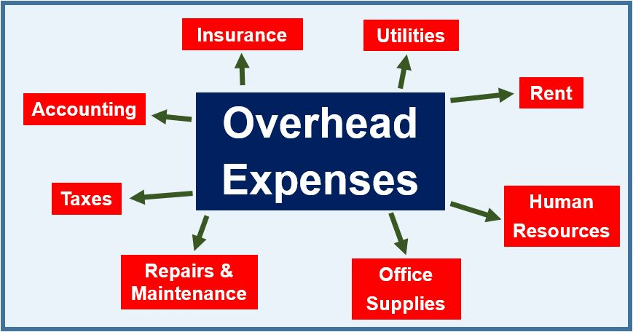
Step 5 – Look at the Details
How Do You Get Paid?
How is overhead determined?
Split evenly
Based on clinic use
Based on collections

Slide 24
Step 5 – Look at the Details
How Do You Get Paid?
Is there an ancillary income revenue stream?
MRI, PT, surgery ctr, DME
Does everyone have an equal share?
Do you buy in?
When does it start?
After you make partner

Slide 25
Step 5 – Look at the Details
Practice Specifics
How are patients divided?
Evenly
All to you until you are busy
Well-insured/good cases go to the senior partner
To Dr. A To Dr. B
Great Bad
Fun Case Dumps
Normal Difficult
InsuranceCase:
Patient:

Slide 26
Step 5 – Look at the Details
Practice Specifics
How long until partner?
What does that mean?
Pay to buy in?
To what?
Vote
Share in ancillaries

Slide 27
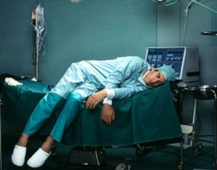
Step 5 – Look at the Details
Practice Specifics
How is call decided?
How much call do you take?
Do you have any control over that?
Is there an age when people do not take call?
Is there pay for call?

Slide 28
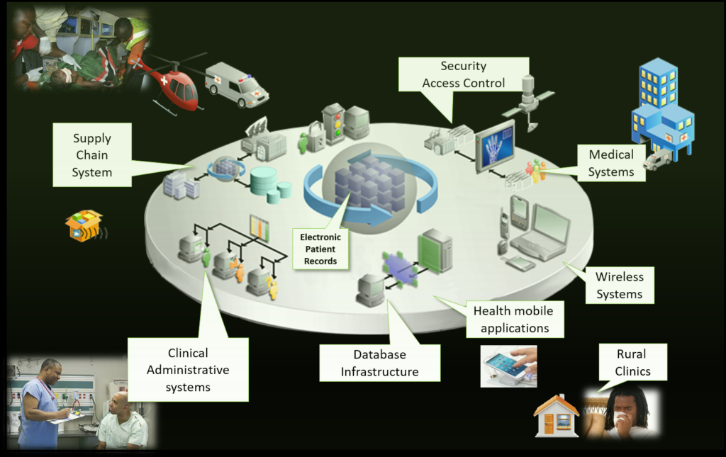
Step 5 – Look at the Details
Practice Specifics
Does your group have infrastructure for:
Expansion for your arrival?
Electronic medical records?
Value assessment?

Slide 29
Step 5 – Look at the Details
Staffing
Do you get assistants?
Who picks your assistants?
In clinic
In office
Same person?
Nurses in clinic
Receptionist
APPs

Slide 30
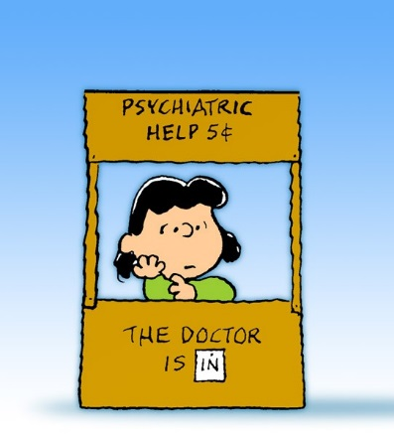
Step 5 – Look at the Details
General Considerations
Are you starting a new practice or taking over someone’s practice?
Why did they leave?
ORTHOPAEDIC

Slide 31
Step 5 – Look at the Details
General Considerations
Are your priorities aligned with the group’s/partners in the group?
Are you the only academically minded person in a private group or vice versa?

Slide 32
Part II: Summary
Know what you want
Start early
Make a list, discuss with family, and revisit it
Start broad, work towards details
How does the job line up with your list of preferences?
Think big picture, long-term
Trust your gut
Understand best/worse case scenarios
Save the details for the end
Make your decision

Slide 33
Part III: Practice Options – Advantages/Disadvantages
Solo/Small Group Practices
Private Large Group Practice
Hospital/Hospital System Practice
Academic Practice

Slide 34
Solo/Small Group: PROS
You are in control: PRIDE
You are your own BOSS
You build the practice
Marketing
You choose what to do

Slide 35
Solo/Small Group: CONS
Must have a business sense
Costs
Equipment (xray, EPIC, office)
Personnel
Time off
Who covers call
Who answers patient questions
Complications if you are gone
Hard work to build a practice

Slide 36
Private Large Group Practice: PROS
Business based on production
Production determines income
Need clinical efficiency (learned)
Pick your assistants (PA,NP, MA etc)
Ownership (Surgicenter, MRI etc)
Marketing already present?

Slide 37
Private Multispecialty Practice: CONS
Administrative
Board
Hospital
Rounding
Multiple hospitals
Weekends?
Business based on production
Have to build practice
Know the competition
Group
Community

Slide 38
Hospital/Hospital System Employee: PROS
Professional Service Agreement (PSA)
Hospitals need doctors/surgeons
Physicians maintain independence
Flexibility & stability
Do not have to maintain practice
Can expand practice together

Slide 39
Hospital/Hospital System Employee: CONS
Less control over employees
Less control over services
May provide lots of $$$ for first two years….To entice: can you meet your numbers?
May build practice with younger, less experienced partners

Slide 40
Academic Practice: PROS
Working with Residents
They do work
You can see them grow
Teaching and Mentoring
Research
Exposure to “Cutting Edge”
Staying abreast of education

Slide 41
Academic Practice: CONS
Residents
Take time
Hierarchy exists
Academic productivity required for promotion
Administrative day?
Protected time

Slide 42
Part III: Summary
REALIZE: No job is perfect
Know what to expect
Do your homework in advance
It still might not work out…

Slide 43
Part IV: Getting the Job You Want
Networks
Fellowship directors
Job directories
Cold emailing
Consultants

Slide 44
Established Network
Keep in mind you have already been in the profession for 6 years
You have an established network of attendings from residency and fellowship
You have a network of co-residents and past residency graduates
These attendings and residents have their own professional (including places they trained) and personal network that may have contacts in your desired location and practice setting
Engage your network to find job opportunities

Slide 45
Fellowship Director (FD)
Your FD has a vested interest in getting you to the next step (job)
You should count your FD as part of your network
Your FD may have more contacts especially in academic settings due to the academic nature of the position
Your FD can connect you to past graduates of the fellowship who are in regions of interest

Slide 46
Job Listings/Directories
Utilize the job listings on the AAOS website
Utilize the job listings on any sub-specialty websites
Utilize advertisements in JBJS, JAAOS and your specialty journals

Slide 47
Cold Emailing
With the internet it is very easy to find practices and their contact information in your desired location
It is also easy to find contact information for academic/hospital practices
Email practices in places you would like to practice to see if there are positions
Sometimes they may not have a position only because they are not planning ahead; your contact may make them evaluate their situation and they may realize they could use someone in 9 -12 months
Your email should be brief – introduce yourself, tell them where you are training right now, what your ties to the regions are, when you would like your position to start, what you are looking for in a practice, and attach your CV

Slide 48
Consultants
As a last resort use consultants
Consultants are useful if you are looking for a job in a region in which you are unfamiliar and you have no contacts
Typically, any job that is worthwhile will be advertised in a major orthopaedic website or journal so a consultant will not add to your search
Consultants will bombard you with undesirable job offerings even after your search is over

Slide 49
Part V: Additional Educational Resources
AAOS
JBJS
American College of Surgeons
American Medical Association
Sub-specialty Societies

Slide 50
AAOS
AAOS Career Center Job Board (https://www.healthecareers.com/aaos/search-jobs/)

Slide 51
JBJS
JBJS Career Center
(http://careers.jbjsjobs.org/jobs/search/)

Slide 52
JAMA
American Medical Association Career Center (https://careers.jamanetwork.com/)

Slide 53
American College of Surgeons
American College of Surgeons Career Center (https://surgeonjobs.facs.org/)

Slide 54
Subspecialty Societies
AOSSM
Job board
https://www.sportsmed.org/aossmimis/Members/About/Professional_Opportunities/Members/About/Professional_Opportunities.aspx?hkey=d456cec2-4e6b-4477-aa82-bffec74a898c
ASES
Job board
https://www.ases-assn.org/about-ases/shoulder-and-elbow-career-opportunities/
AAHKS
Practice Resources (clinical practice guidelines, ICD-10 coding, risk stratification, performance measures)
http://www.aahks.org/practice-resources/
Job Center
https://careers.aahks.org/
NASS
Job Board
https://careers.spine.org/

Slide 55
Subspecialty Societies
OTA
Young Practitioners Resources "Finding your first job in an academic setting"
and "Finding your first job in a private setting".
https://ota.org/fellowship/young-practitioners
Practice management & coding resources (members only)
https://ota.org/careers-practice
Job Board
https://ota.org/careers-practice/job-board
POSNA
Job Board
https://posna.org/Resources/Job-Board/Find-A-Job
MSTS
none

Slide 56
Subspecialty Societies
AOFAS
Practice Management Resources (members only)
https://prc.aofas.org/Public/Catalog/Details.aspx?id=gcuLJu7tV/u7OO2C%2bR/7pQ%3d%3d&returnurl=/Users/UserOnlineCourse.aspx?LearningActivityID%3dgcuLJu7tV%2fu7OO2C%2bR%2f7pQ%3d%3d
Job Board
https://careers.aofas.org/jobs/
ASSH
Webinars on Practice management -Choosing the best practice for me: academic/private (members only)
https://www.assh.org/search-results?searchTerm=practice management
Job Board
https://jobs.assh.org/jobs/
AANA
Practice management- Coding, Career & Practice Mgmt Videos including “Finding the Right Job” (members only)
https://www.aana.org/AANAIMIS/Members/Education/Online_Education/Members/Education/Online-Education.aspx?hkey=fcc3eb02-1a8a-4ea6-8601-1c0d081b5fea

Slide 57
Please help us improve our support of best practices in education: Use this survey to provide your feedback about this module.
Submit questions or comments about the
Transition to Practice Lecture Series to cord@aoassn.org

